Slide 1


시각 Tech. 심화과정 (2)
연세대학교 컴퓨터과학과
김 선 주

Slide 2
AGENDA
Image Processing
- Color Constancy (White Balance) - Colorization - Super-Resolution - In-camera image processing

Slide 3
Color Constancy

Slide 4
Approaching the Computational Color Constancy as a Classiﬁcation Problem through Deep Learning
Seoung Wug Oh | Yonsei University
Seon Joo Kim | Yonsei University
 | Pattern Recognition, 2017
Notes:
.

Slide 5
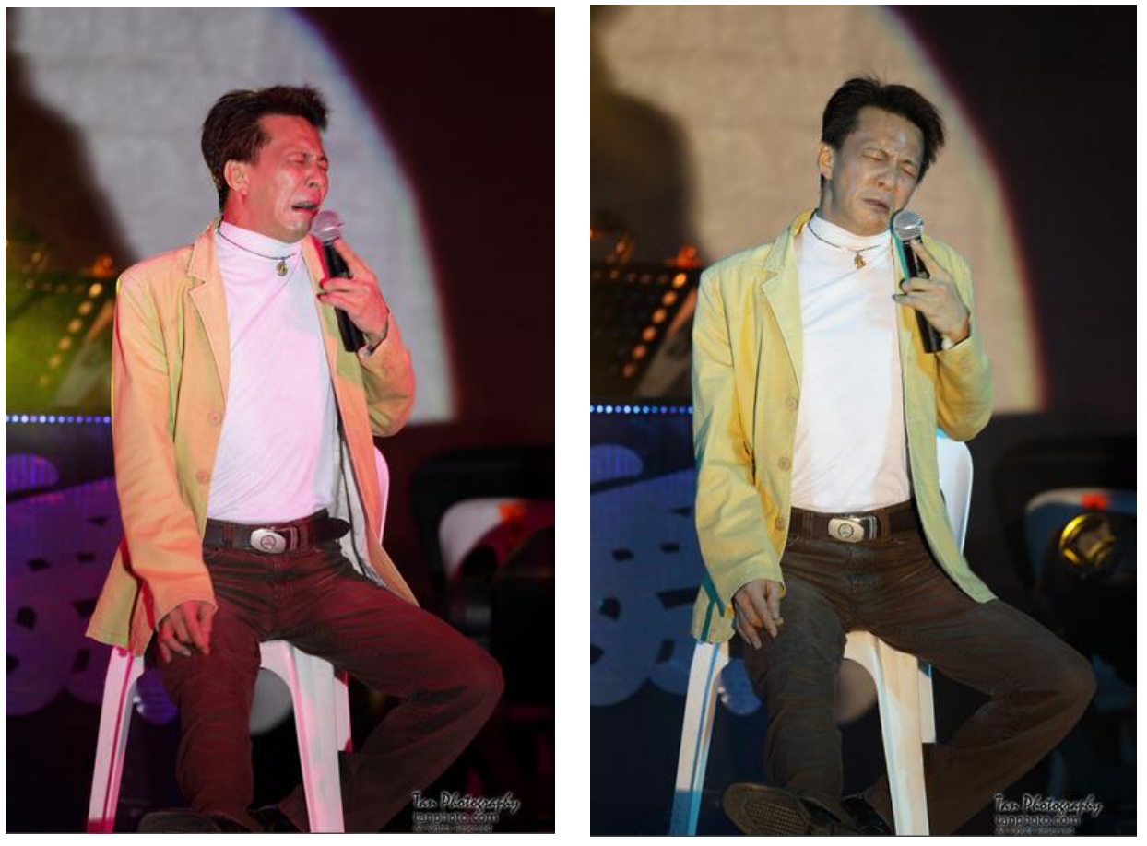
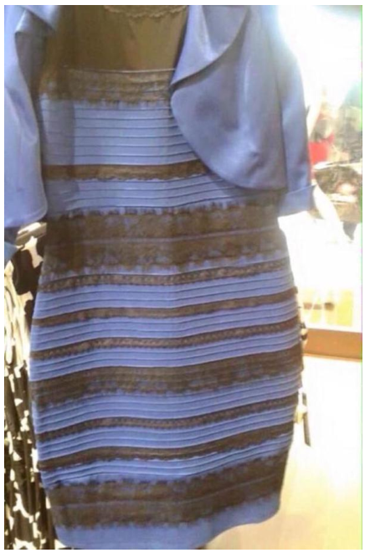
Computational Color Constancy
Color constancy
Def. A feature of the human color perception system which ensures that the perceived color of objects remains relatively constant under varying illumination conditions

Slide 6
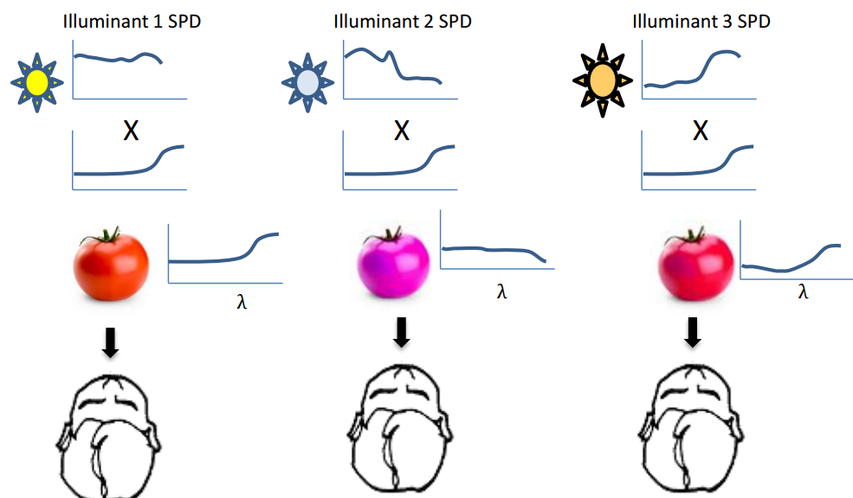
Computational Color Constancy
Surface reflectance
Incoming light
Figure from CVPR2016 tutorial “Understanding the In-Camera Image Processing Pipeline for Computer Vision “,M.S. Brown (NUS)

Slide 7
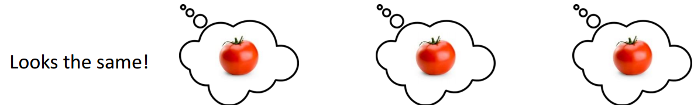
Computational Color Constancy
Surface reflectance
Incoming light
Figure from CVPR2016 tutorial “Understanding the In-Camera Image Processing Pipeline for Computer Vision “,M.S. Brown (NUS)

Slide 8
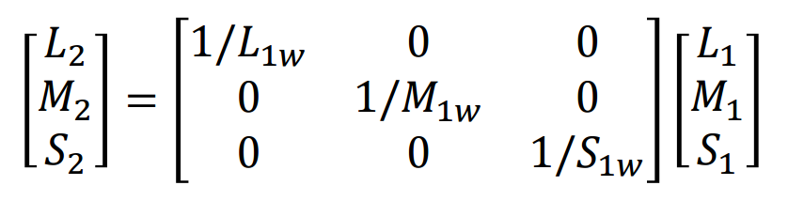
Computational Color Constancy
Computational color constancy
simulate this capability of Human visual system
estimate illumination color given an image
White balancing
eliminate the influence of lighting
make the photo look like it was taken under a white light
Von Kries model:

Slide 9
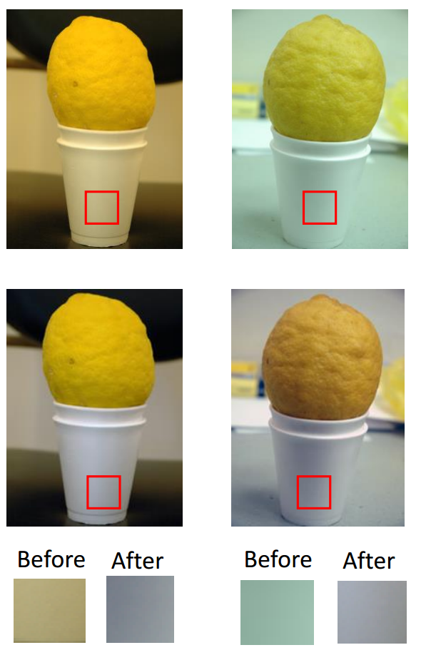
Computational Color Constancy
Input
White Balancing
“White” object now looks “white”
Output
Figure from CVPR2016 tutorial “Understanding the In-Camera Image Processing Pipeline for Computer Vision “,M.S. Brown (NUS)

Slide 10
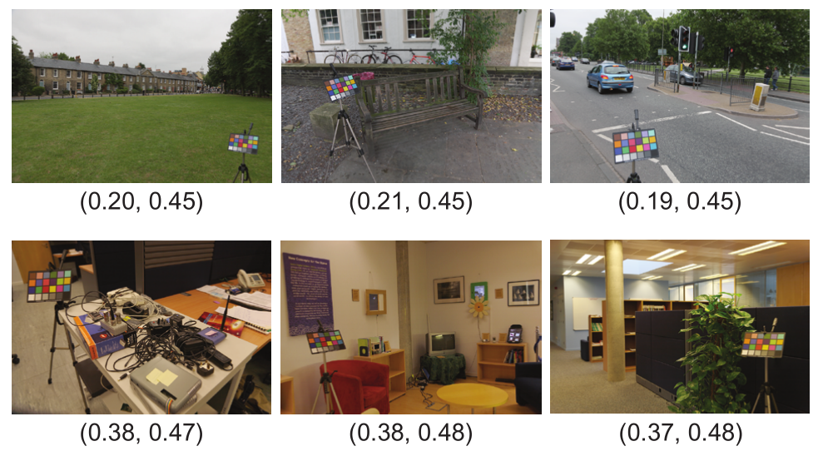
Real World Illumination

Slide 11
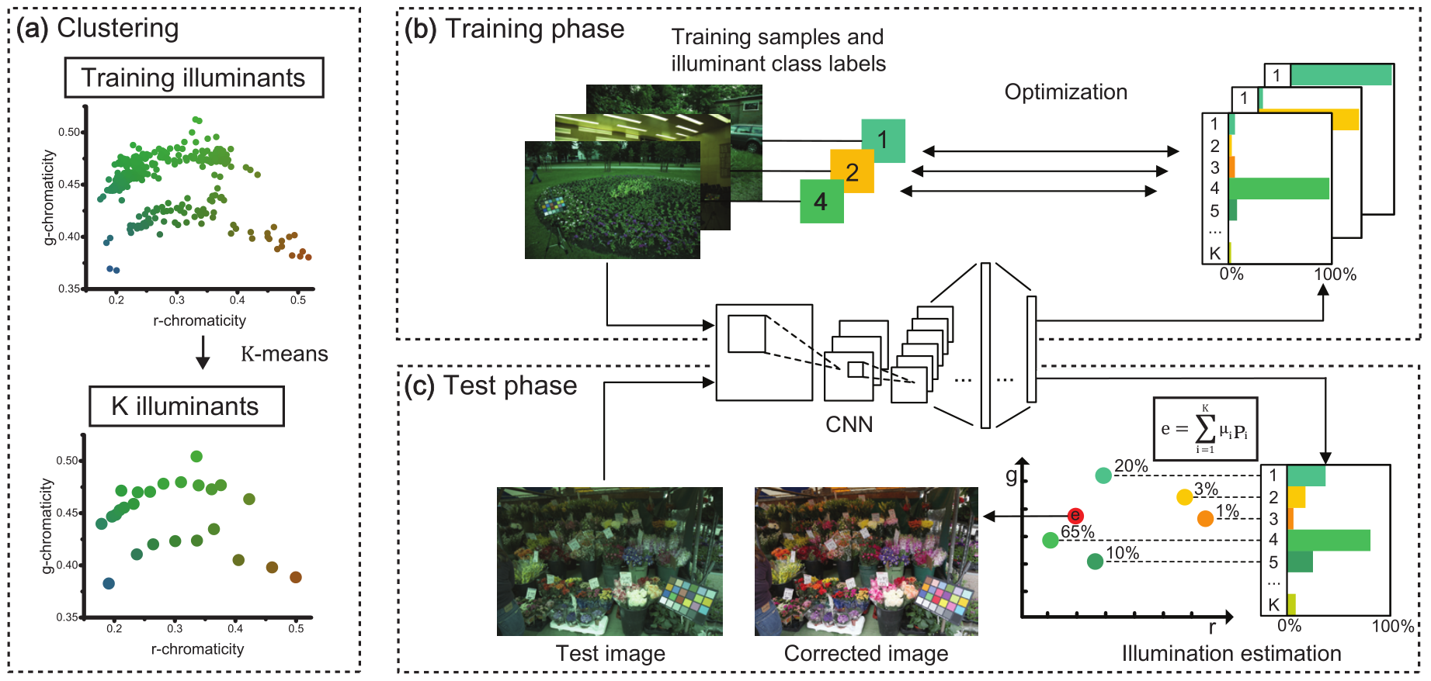
Algorithm Overview

Slide 12
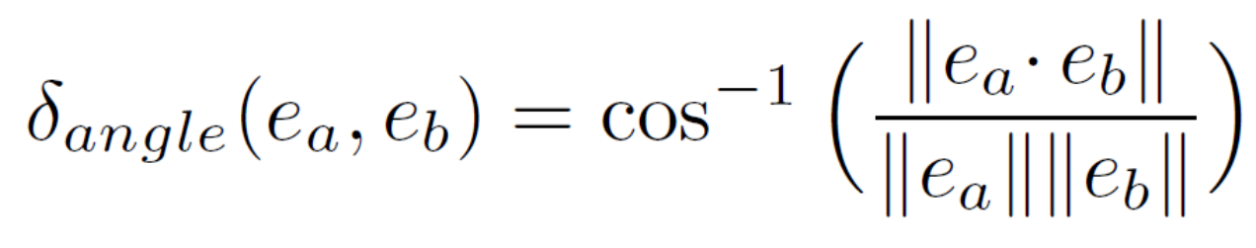
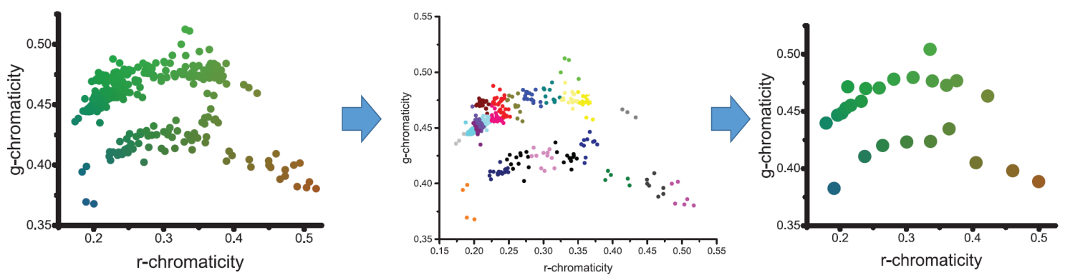
Illumination Clustering
K-means clustering with the angular distance
Training illumination
Assigning labels
Cluster center

Slide 13
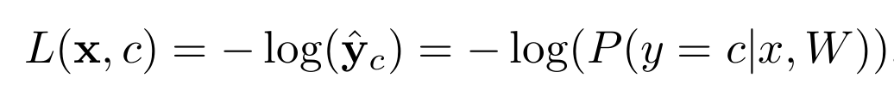
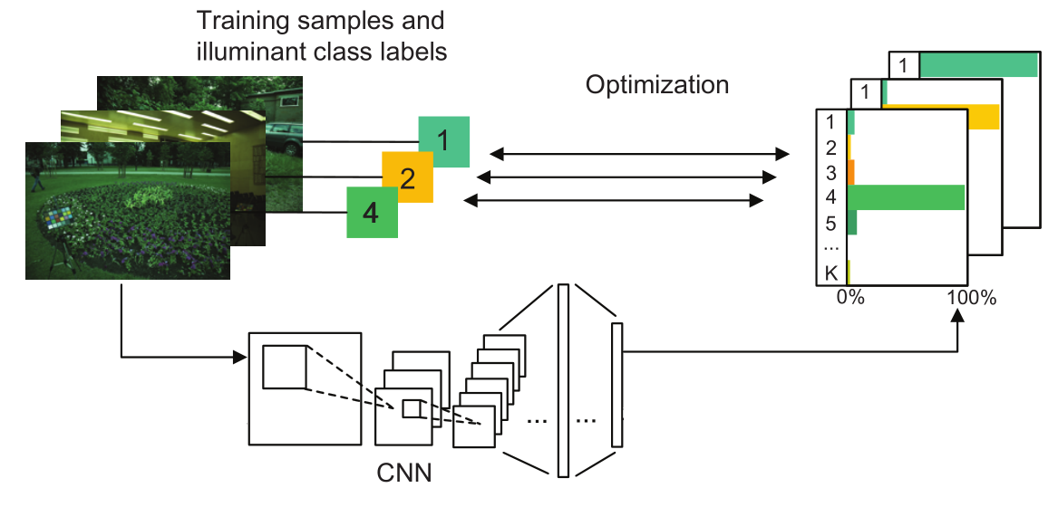
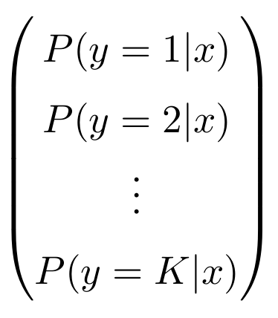
Training
Train CNNs to classify the illumination clusters

Slide 14
Training
Lack of training data
Dataset | Samples
Gehler-Shi set | 568 RAW images
SFU Grayball set | 15 video clips
NUS 8-camera set | 1600 RAW images (200 scenes x 8 cameras)
Data augmentation: Rotation, Translation, Scale, and Flip No color related transform
Transfer learning: Weights pre-trained on ImageNet
A Krizhevsky et al . "Imagenet classification with deep convolutional neural networks." NIPS. 2012.

Slide 15
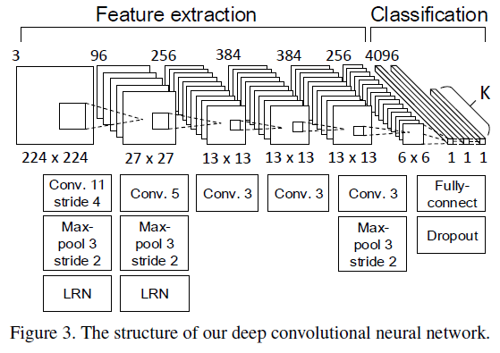
Training
Fine-tuned from AlexNet pretrained on ImageNet
A Krizhevsky et al . "Imagenet classification with deep convolutional neural networks." NIPS. 2012.

Slide 16
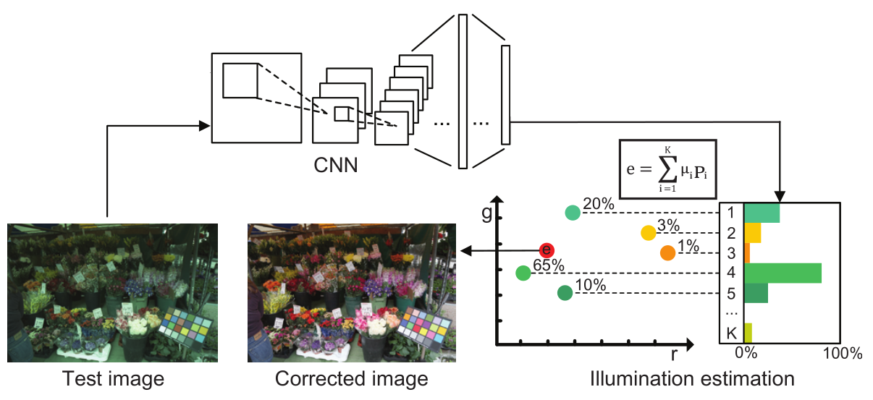
Illumination Estimation
Weighted sum of cluster centers with CNN’s output : probability distribution over clusters

Slide 17
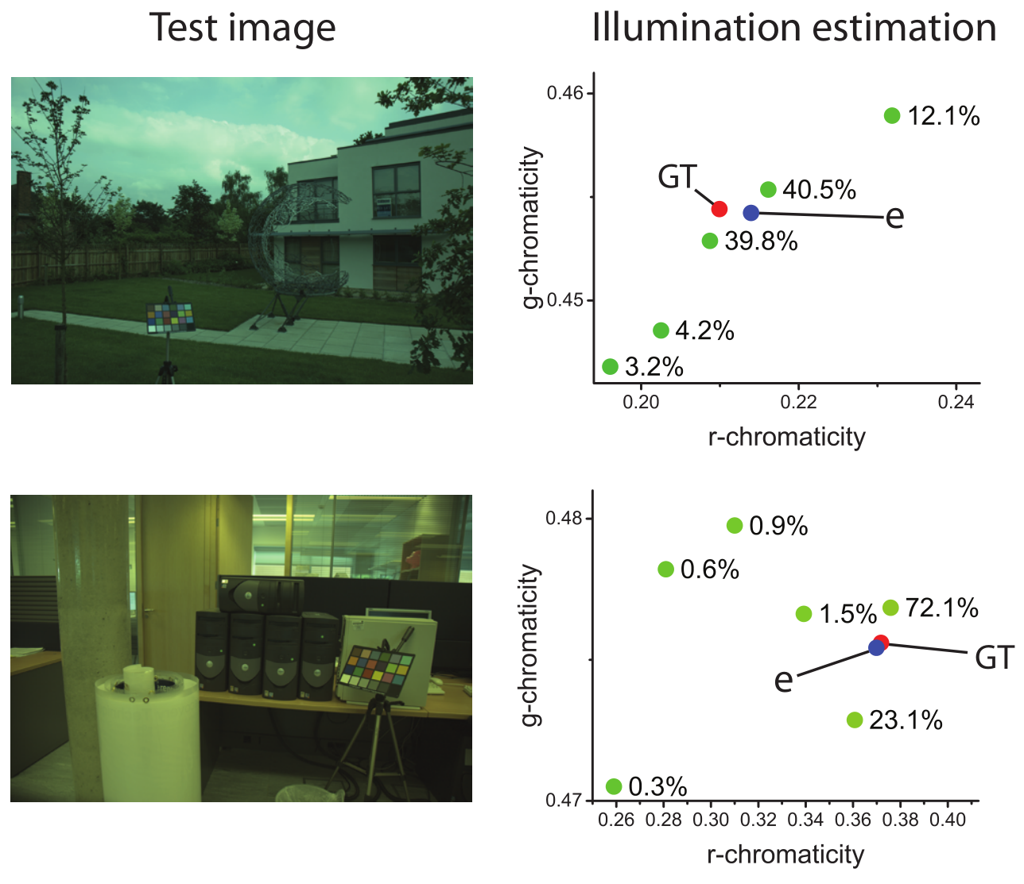
Illumination Estimation
Real Examples

Slide 18
Results
Method |  | Mean | Median | Trimean | Best-25% | Worst-25%
Statistics -Based | Grey-world | 6.36 | 6.28 | 6.28 | 2.33 | 10.58
 | White-patch | 7.55 | 5.68 | 6.36 | 1.45 | 16.15
 | Shades-of-Grey | 4.93 | 4.01 | 4.23 | 1.14 | 10.22
 | General Grey-world | 4.67 | 3.46 | 3.81 | 0.98 | 10.21
 | $1^{st}$-order Grey-Edge | 5.33 | 4.52 | 4.73 | 1.86 | 10.05
 | $2^{nd}$-order Grey-Edge | 5.13 | 4.44 | 4.63 | 2.11 | 9.27
 | Bright-and-dark Colors PCA | 3.52 | 2.14 | 2.47 | 0.5 | 8.74
 | Double-Opponency | 4.03 | 2.6 | - | - | 9.35
 | Local Surface Reflectance | 3.31 | 2.8 | 2.87 | 1.14 | 6.39
 | Grey Pixels | 4.6 | 3.1 | - | - | -
Learning -Based | Pixel-based Gamut | 4.2 | 2.33 | 2.92 | 0.5 | 10.75
 | Edge-based Gamut | 6.72 | 5.6 | 5.8 | 2.05 | 13.5
 | Intersection-based Gamut | 4.21 | 2.34 | 2.91 | 0.5 | 10.78
 | Regression (SVR) | 8.08 | 6.73 | 7.19 | 3.35 | 14.92
 | Bayesian | 4.82 | 3.46 | 3.89 | 1.26 | 10.51
 | Spatio-spectral | 3.59 | 2.96 | 3.05 | 0.91 | 7.45
 | High-level Visual Information | 3.48 | 2.47 | 2.61 | 0.84 | 8.03
 | Natural Image Statistics | 4.19 | 3.13 | 3.45 | 1 | 9.24
 | CART-based Combination | 3.9 | 2.91 | 3.23 | 1.02 | 8.29
 | Bilayer Sparse-Coding | 4 | 2.5 | 2.8 | 1 | 10.8
 | Exemplar-based | 2.89 | 2.27 | 2.42 | 0.82 | 5.98
 | 19 Edge Moments | 2.8 | 2 | - | - | -
 | Simple Feature Regression | 2.42 | 1.65 | 1.75 | 0.38 | 5.87
 | Alexnet+SVR | 4.74 | 3.09 | 3.52 | 1.1 | 11.11
 | CNN Regression | 2.63 | 1.98 | 2.13 | 0.74 | 5.64
 | Luminance-to-Chromaticity | 2.56 | 1.67 | 1.89 | - | -
 | Proposed | 2.16 | 1.47 | 1.61 | 0.37 | 5.12

Slide 19
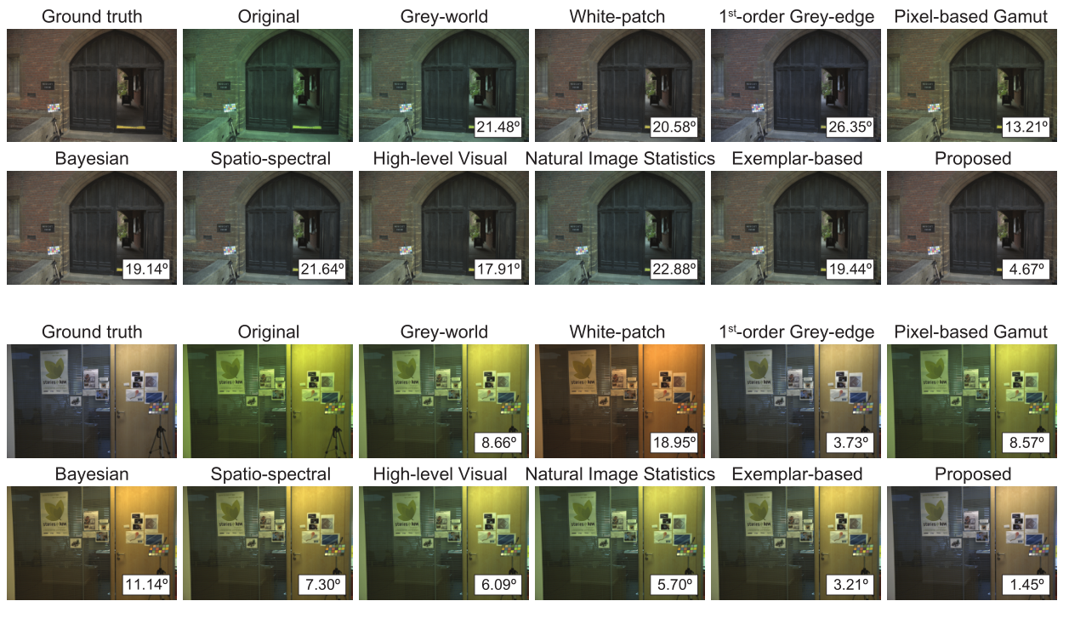
White Balancing

Slide 20
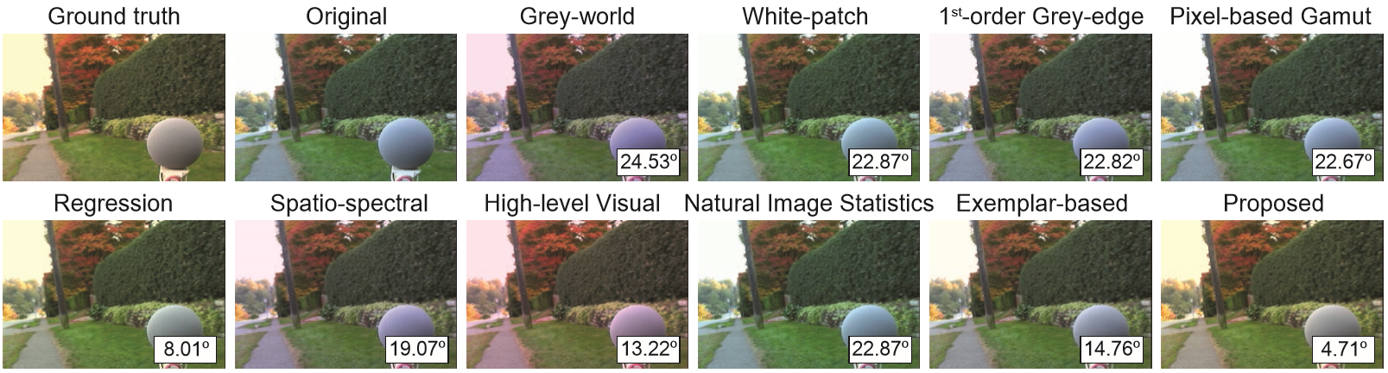
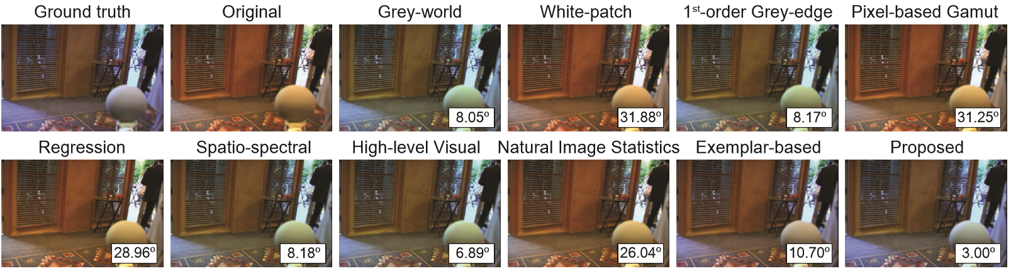
White Balancing

Slide 21
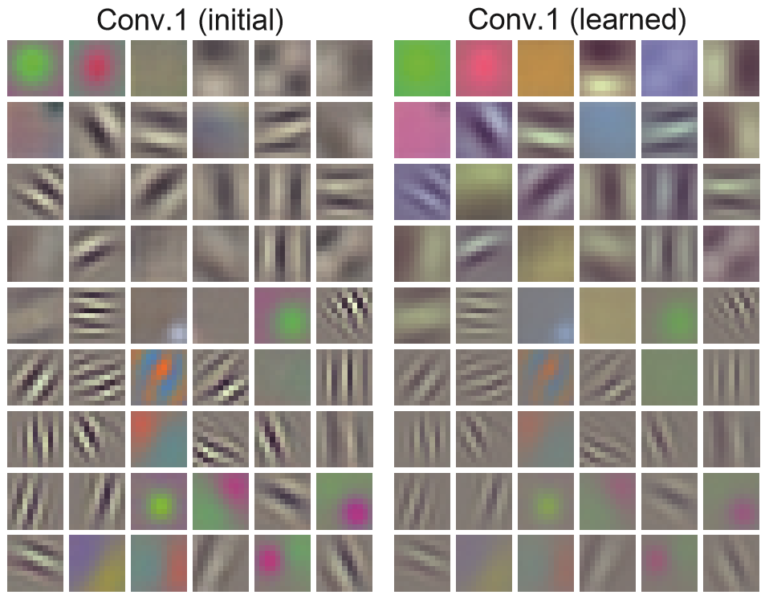
Feature Visualization
First convolutional layer’s weight

Slide 22
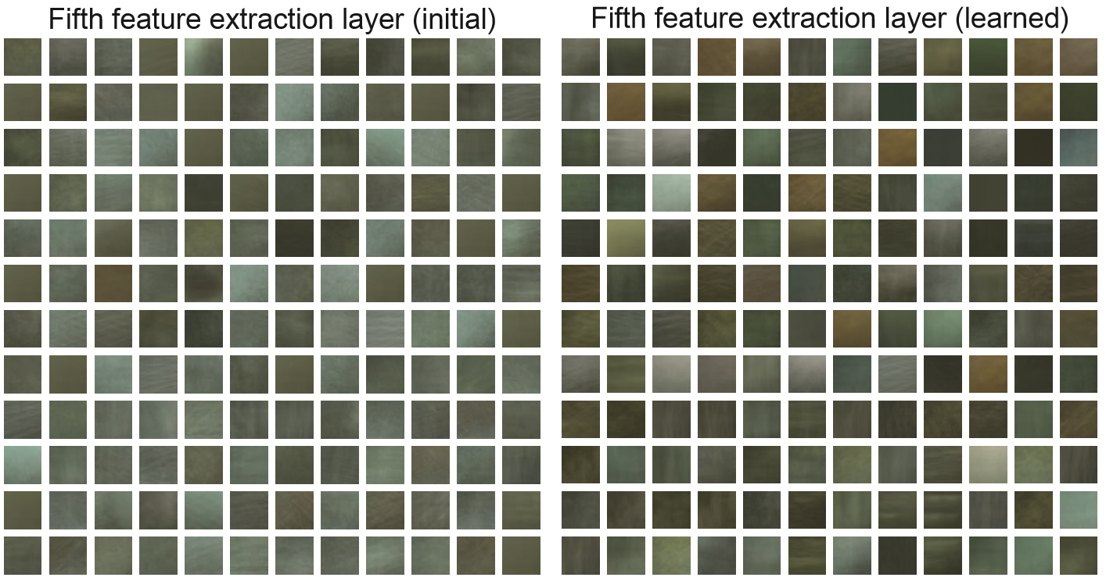
Feature Visualization
5th convolutional layer: mean of top 300 receptive ﬁelds that give the largest response

Slide 23
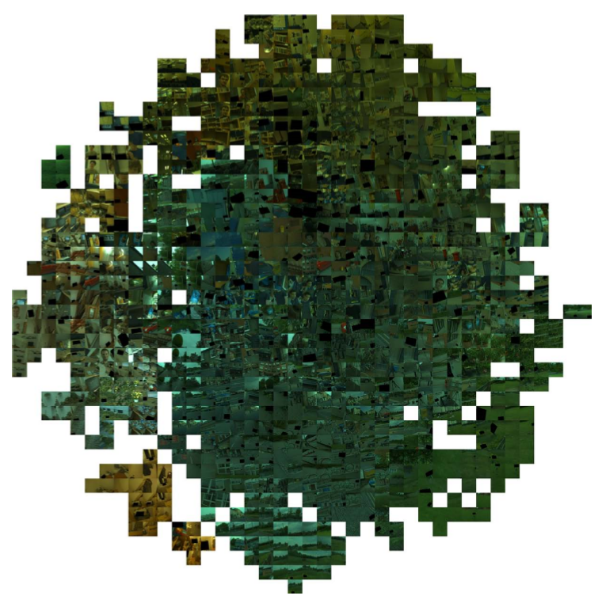
Feature Visualization
Final fully-connected layer: t-SNE embedding

Slide 24
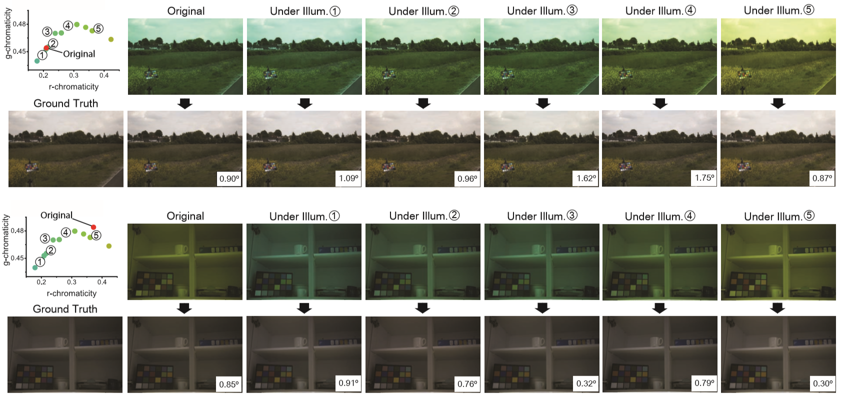
Synthetic experiment
Synthetically generate test samples using different illumination

Slide 25
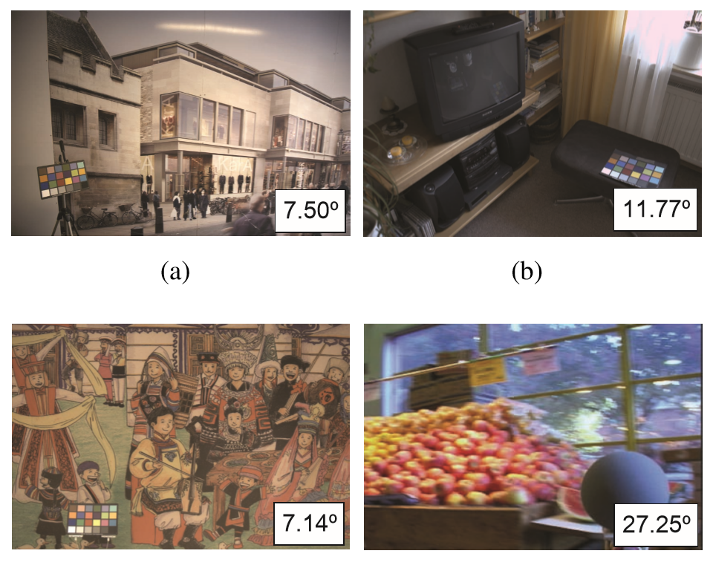
Failure cases
Unrealistic scenes Wrong ground truth

Slide 26
colorization

Slide 27
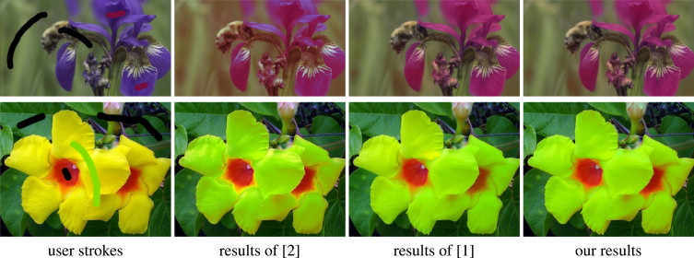
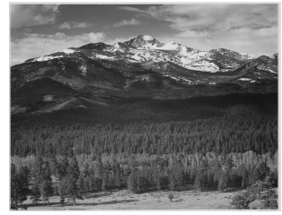
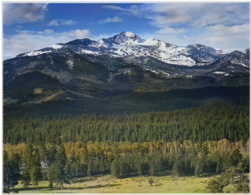
Let there be Color!: Joint End-to-end Learning of Global and Local Image Priors for Automatic Image Colorization with Simultaneous Classification
Introduction: Image Colorization
User guided edit propagation
Data-driven automatic colorization
Colorization Method

Slide 28
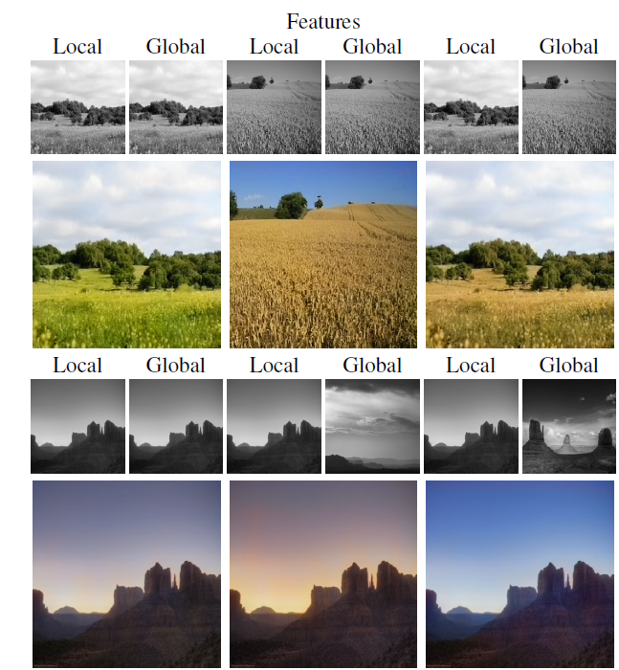
Introduction: Image Colorization
Global image priors, which are extracted from the entire images.
Local image features, which are computed from small image patches.
Fuse them together to perform the final colorization.

Slide 29
Introduction: Image Colorization
Global image priors, which are extracted from the entire images.
Local image features, which are computed from small image patches.
Fuse them together to perform the final colorization.
Predict the chrominance of a grayscale image using CIEL*a*b*.
Everything is learnt in an end-to-end fashion.
Change the style of the resulting colorization.

Slide 30
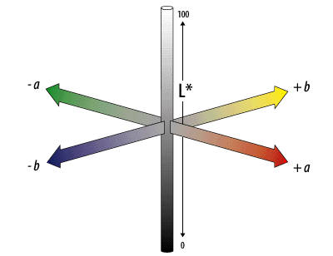
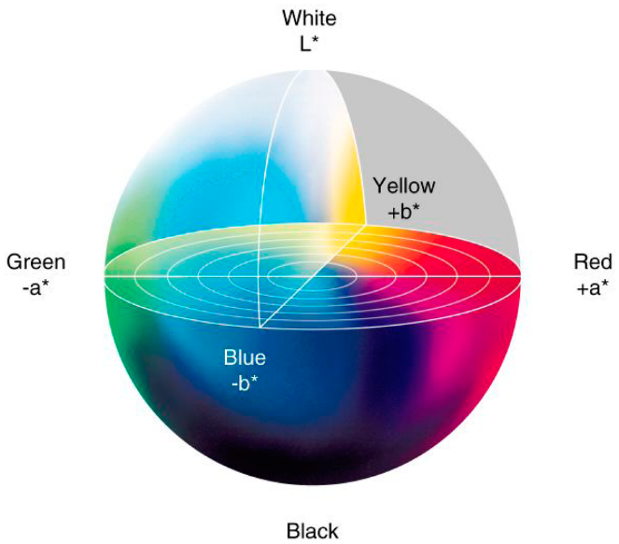
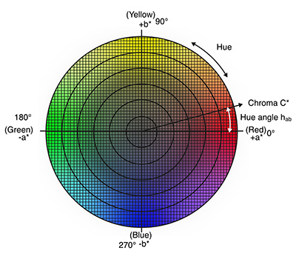
CIEL*a*b* Color Space

Slide 31
Architecture

Slide 32
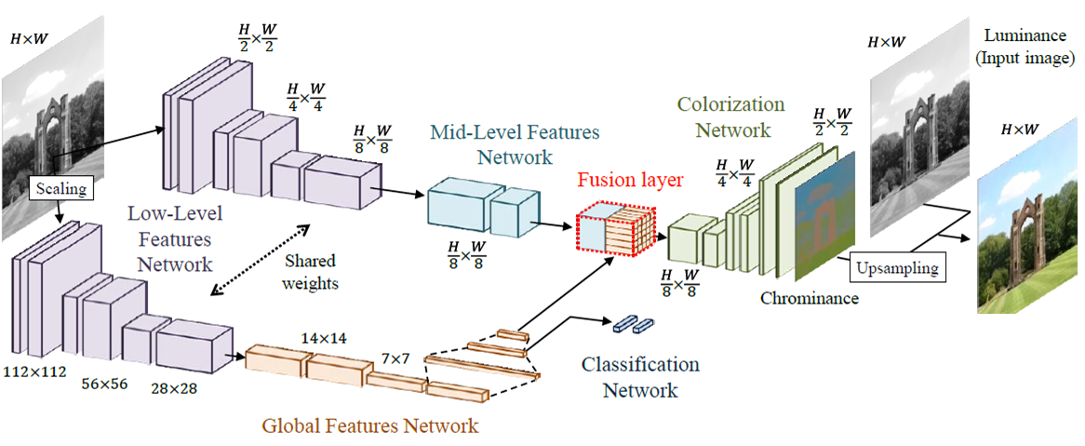
Network Architecture

Slide 33
Network Architecture
Fusion of local and global features from images to colorize an image automatically.

Slide 34
Network Architecture
Fusion of local and global features from images to colorize an image automatically.
End-to-end network

Slide 35
Network Architecture
Fusion of local and global features from images to colorize an image automatically.
End-to-end network
A user-intervention-free approach (Data-driven method)

Slide 36
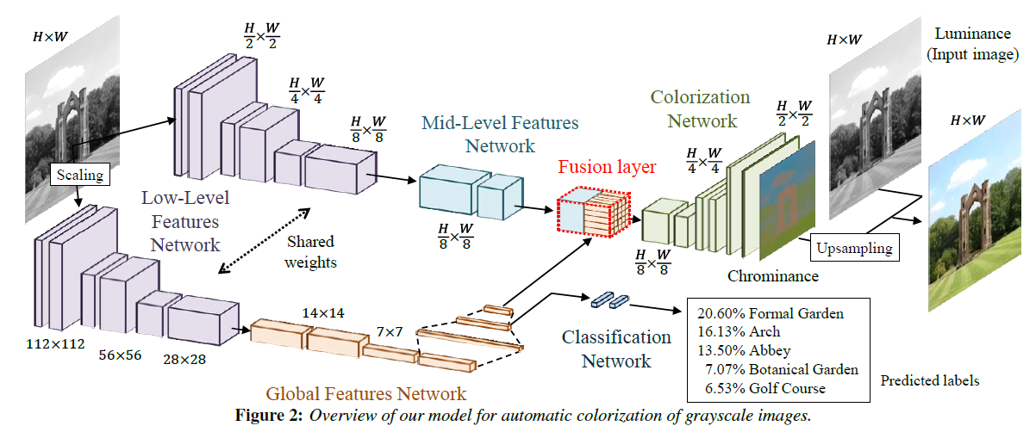
Network Architecture
Fusion of local and global features from images to colorize an image automatically.
End-to-end network
A user-intervention-free approach (Data-driven method)
Using Classification labels to increase performance.

Slide 37
Joint Global and Local Model

Slide 38
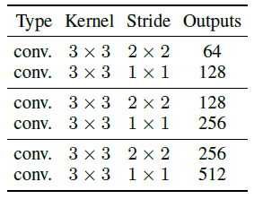
Low-Level Features Network
Convolutional Layers 6.
Stride = 2 instead of maxpooling.
Arbitrary resolution as input images.
Global feature networks requires 224 x 224 images sizes.

Slide 39
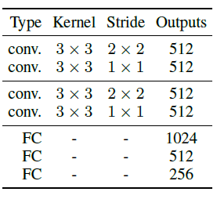
Global Image Features Network
Convolutional Layers 4
Fully-Connected Layers 3
Fixed size of 224 x 224 pixels
Output 256-dimensional vector

Slide 40
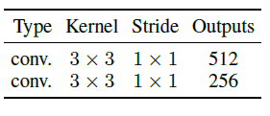
Mid-Level Features Network
Fully Convolutional Networks 2.
Output with depth of 256.

Slide 41
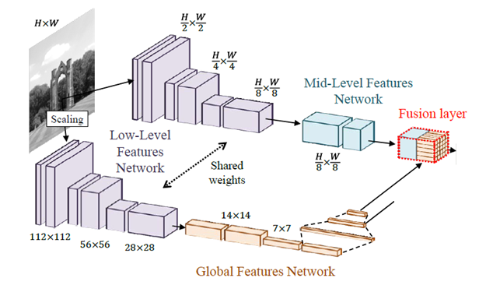
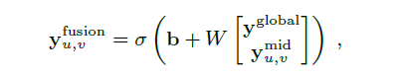
Fusing Global and Local Features
W is a 256 x 512 weight matrix
b is a bias

Slide 42
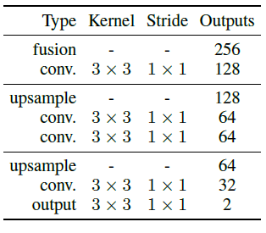
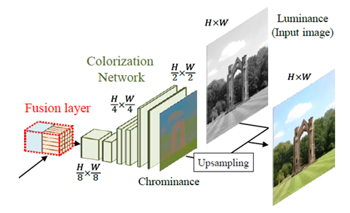
Colorization Network
Loss = MSE(output, target)
Last upsampling by nearest neighbour technique
Output: a*, b*

Slide 43
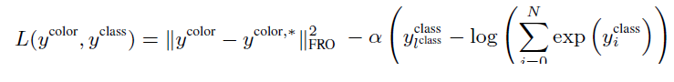
Colorization with Classification
Color Loss
Classification Loss

Slide 44
Optimization and Learning
More efficient with input images as 224 x 224 pixels
ADADELTA [Zeiler 2012]
Adaptively sets the learning rates for all the network parameters
Batch normalization
Randomly flip the images horizontally

Slide 45
Experiment Results and Discussion

Slide 46
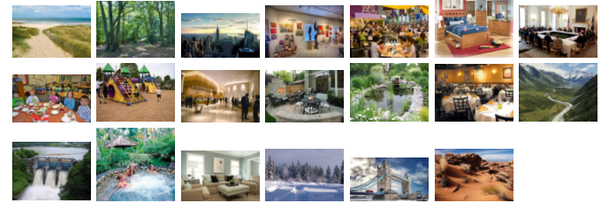
Experimental Results and Discussion
α= 1/300
Training images 2,327,958 (Places scene dataset)
Validation images 19,546
Batch size 128
11 epochs with 200,000 iterations each
Training time 3 weeks (NVIDIA Tesla K80 GPU)

Slide 47
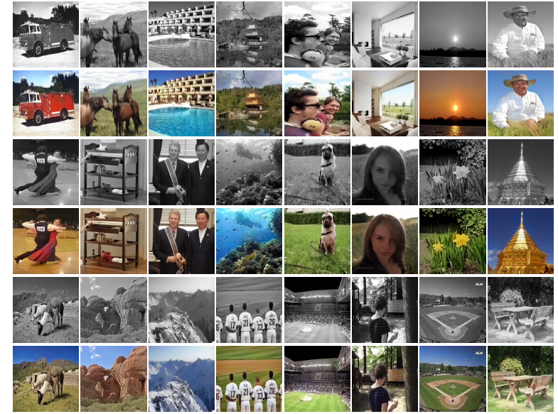
Colorization Results

Slide 48
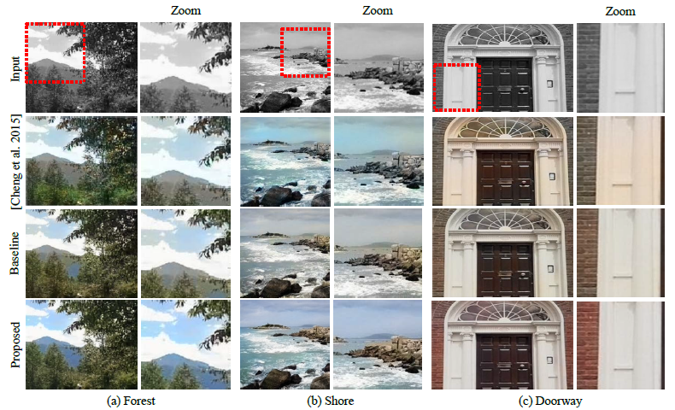
Comparison with State of the art

Slide 49
Style Transfer through Global Features

Slide 50
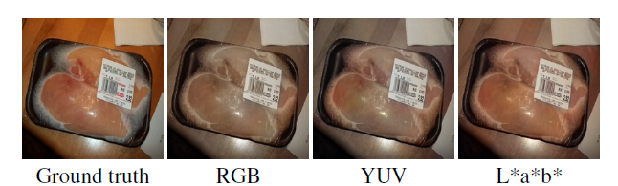
Comparison of Color Space

Slide 51
Limitations
Data-driven method, colorization depends of the similarity between the input images and the training dataset.
Color style transfer is strongly conditioned to images from the same class.
Long time for training (large dataset, 3 weeks).
The method does not explore the advantage of uniform color space as CIEL*a*b*

Slide 52
Conclusion

Slide 53
They addressed colorization of grayscale images using convolutional neural networks.
They presented a novel architecture by fusing global and local features for better understanding of the colors to the images.
CNN architecture was trained end-to-end.
Automatic Colorization.
Style transfer through global features.
The network is able to handle any resolution of the images as an input.
Conclusions

Slide 67
https://youtu.be/eL5ilZgM89Q

Slide 69
Super-resolution

Slide 70
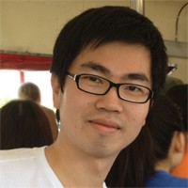
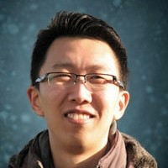
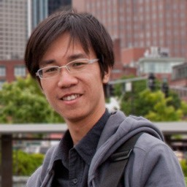
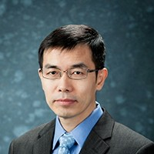
Image Super-­‐Resolution Using Deep Convolutional Networks
C. Dong, C. C. Loy, K. He, X. Tang
IEEE Transactions on Pattern Analysis and Machine Intelligence, 2015 European Conference on Computer Vision, 2014

Slide 71


Single image super-resolution
Low resolution (LR)
High resolution (HR)
2x upscaling
Reconstruct a high-­‐resolution image from a given low-­‐resolution image

Slide 72
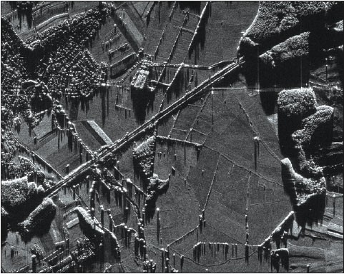
Applications
Digital high definition TV – From SDTV to HDTV
Medical Imaging
Satellite imaging
CCTV surveillance (car plate or face)
Airborne surveillance

Slide 73













Single image super-resolution
Low resolution (LR)
High resolution (HR)
2x upscaling
Example-­‐based SR
external databases

Slide 74

Example-based methods
Exploitinternal similarities of the same image
Glasner, D., Bagon, S., Irani, M.: Super-resolution Vision. pp. 349–356 (2009)
from a single image. In: IEEE International
Conference on Computer

Slide 75
Example-based methods
Learn mapping functionsfrom external low-­‐ and high-­‐resolution exemplar pairs
Overlapping patches are densely cropped from the input image and pre-processed
Patches are encoded by a low-resolution dictionary
The sparse coefficients are passed into a high-resolution dictionary for reconstructing high- resolution patches
Constructed patches are aggregated (e.g., by weighted averaging) to produce the final output
[1] J. Yang et al., T.: Coupled dictionary training for image super-­‐resolution. TIP 21(8), 3467-­‐3478 (2012) [2] J. Yang et al., Image super-­‐resolution via sparse representation. TIP 19(11), 2861-­‐2873 (2010)
15

Slide 76
Contributions
We directly learn an end-­‐to-­‐end mapping between low-­‐ and high-­‐ resolution images, with no extra pre/post-­‐processing beyond the optimization
We shows that the traditional sparse coding SR method can be viewed as deep convolutional neural network.
We demonstrate deep learning is useful in the classical computer vision problemof super-­‐resolution, and can achieve good quality and speed.
16

Slide 77

Super-resolution CNN (SRCNN)
Put together operationsthat were traditionally treated individually
Patch extraction and representation
Non-­‐linear mapping
Reconstruction

Slide 78
Super-resolution CNN (SRCNN)
Patch extraction and representation
F₁(Y) = max (0, W₁ ⇤ Y + B₁)
f1 ⇥ f1 ⇥ n1 filters
n1 -­‐dimensional biases

Slide 79
Super-resolution CNN (SRCNN)
Non-­‐linear mapping
F₂(Y) = max (0, W₂ ⇤ F₁(Y)+ B₂)
n₁ ⇥ 1 ⇥ 1 ⇥ n₂ filters
n2 -­‐dimensional biases

Slide 80
Super-resolution CNN (SRCNN)
Reconstruction
F (Y) = W₃ ⇤ F₂(Y)+ B₃
n₂ ⇥ f₃ ⇥ f₃
filters
1-­‐dimensional biases

Slide 81









Relation to the sparse-coding-based methods
responses
of patch of
neighbouring patches
Patch extraction and representation
Non-linear mapping
Reconstruction
Sparse coding |  | SRCNN
Extract f₁ × f₁ low-­‐ resolution patch Mean subtraction Projected onto a (low-­‐resolution) dictionary, | size n₁ | Equivalent to applying n₁ linear image Mean subtraction is absorbed | filters | (f₁ × f₁) on the input

Slide 82
Relation to the sparse-coding-based methods
responses
of patch of
neighbouring patches
Patch extraction and representation
Non-linear mapping
Reconstruction
Sparse coding
SRCNN
Apply sparse coding solver on the projected n₁ coefficients The outputs are n₂ coefficients representing the the high-­‐ resolution patch.
Iterative algorithm
Equivalent to non-­‐linear mapping Feed-­‐forward

Slide 83
Relation to the sparse-coding-based methods
responses
of patch of
neighbouring patches
Patch extraction and representation
Non-linear mapping
Reconstruction
Sparse coding
SRCNN
n₂ coefficients are then projected onto another (high-­‐
resolution) dictionary to produce a high-­‐resolution The over-­‐lapping high-­‐resolution patches are then averaged
Equivalent to to linear convolutions on the n₂ feature maps

Slide 84
Loss function
Estimate`
⇥ = {W₁, W₂, W₃, B₁, B₂, B₃}
Minimizing the loss between the reconstructed images F (Y; Θ) and the correspondingground truth high-­‐resolution images X
n
1
2
L(⇥) = ^{X} ||F (Y_{i}; ⇥) — X_{i}||
n
i=1
The loss is minimized using stochastic gradientdescent with the standard backpropagation

Slide 85










Training data
Yang’s paper [1]
91 images (on average 200x200).
Total 24,800 patches (33x33).
ImageNet
395,909 images from the ILSVRC 2013 ImageNet detection training partition
Decomposed into 5 million sub-­‐images using a stride of 33
[1] J. Yang, et al., "Image super-­‐resolution as sparse representation of raw image patches." CVPR 2008.

Slide 86

Training data
More trainingdata leads to better performance

Slide 87

Filter number
In general, the performance would improve if we increase the network width, i.e., addingmore filters, at the cost of runningtime.

Slide 88

Filter size
A larger filter size leads to better results.
A reasonably larger filter size could grasp richer structural information, which in turn lead to better results
Trade-­‐off between performance and speed

Slide 89

Deeper structure
The deeper the better?
Sensitive to the initialization parameters and learning rate.

Slide 90
Comparisons with existing methods
Structure 9-­‐5-­‐5 trained on ImageNet
Upscaling factors x2, x3, x4
The Set5 (5 images), Set14 (14 images) and BSD200
Evaluation metrics
PSNR, SSIM, IFC, NQM, MSSIM, WPSNR
Yang, C.Y., Ma, C., Yang, M.H.: Single-image super-resolution: A benchmark. ECCV 2014

Slide 91

Comparisons with existing methods
Set5
SC – Sparse coding by Yang et al. TIP 2010
NE+LLE – Neighbour embedding + non-­‐negative least squares by Chang CVPR 2004
KK – Sparse regression and natural image prior by Kim and Kwon TPAMI 2010
ANR – Anchored Neighbourhood Regression by Timofte et al. ICCV 2013
A+ – Adjusted Anchored Neighbourhood Regression by Timofte et al. ACCV 2014
33

Slide 92






SC / 25.58 dB
ANR / 25.90 dB
SRCNN / 27.58 dB
Dong et al., Learning a Deep Convolutional Network for Image Super-­‐Resolution, ECCV 2014

Slide 93






SC / 34.11 dB
ANR / 34.60 dB
SRCNN / 34.91 dB
Dong et al., Learning a Deep Convolutional Network for Image Super-­‐Resolution, ECCV 2014

Slide 94






SC / 33.32 dB
ANR / 33.82 dB
SRCNN / 34.35 dB
Dong et al., Learning a Deep Convolutional Network for Image Super-­‐Resolution, ECCV 2014

Slide 95

Speed comparison
SC – Sparse coding by Yang et al. TIP 2010
NE+LLE – Neighbour embedding + non-­‐negative least squares by Chang CVPR 2004
KK – Sparse regression and natural image prior by Kim and Kwon TPAMI 2010
ANR – Anchored Neighbourhood Regression by Timofte et al. ICCV 2013
A+ – Adjusted Anchored Neighbourhood Regression by Timofte et al. ACCV 2014

Slide 96

Color channels
Cb, Cr channelsbarely help in improvingthe performance.
RGB channels achieves marginally better performance than using Y only

Slide 97
Plausible extensions
Deeper network
Better initialization
More training data
Handle multiple upscaling factors simultaneously
Multiple objectives
E.g. predict image boundary simultaneously
Faster convergence but performances converge given long enough training time

Slide 98
Summary
Deep model formulation inspiredby classical approaches.
Super-­‐resolution CNN
Lightweight
Little pre/post-­‐processing beyond optimization
Performance gain by additional layers/filters
Potential in other low-­‐level vision problems
Caffe model and code
http://mmlab.ie.cuhk.edu.hk/projects/SRCNN.html

Slide 99







Accurate Image Super-Resolution using Very Deep Convolutional Networks
Jiwon Kim, Jung Kwon Lee, and Kyoung Mu Lee
Computer Vision Lab.
Dept. of ECE, ASRI
Seoul National University
http://cv.snu.ac.kr

Slide 100
Our Approach

Slide 101
Motivation
We found limitations in three aspects from existing SR methods (especially, from SRCNN)
Relies on the context of small image regions
SRCNN has only 3 layers (receptive field of 13x13), other methods use even smaller regions
Training converges too slowly
SRCNN uses learning rate of 10⁻⁵. It takes several days to converge
Works for only a single scale
Most existing methods handle different upscaling problem independently

Slide 102


Our Approach for Context
Utilize contextual information spread over very large image regions
For a large scale factor, we need to see more
We employ very deep CNN model
To keep pixel-wise info., avoid pooling
Interpolated LR
HR

Slide 103






Our Approach for fast convergence
Residual image learning
Gradient clipping
Learn
Very sparse!
High resolution (HR)
Low resolution (LR)
clipped gradient flow
L2 loss
Conv / ReLu layer(s)

Slide 104



Our Approach for Scales
Train a single convolutional network to learn and handle multi-scale SR
Different scale helps each other !
Learns to upscale with inter-scale factor !
x2
20 layers
x3
x4
Our VDSR model

Slide 105

Proposed model
Interpolated LR
Conv.1
ReLu.1
Conv.D-1
ReLu.D-1
learned residual
HR
Skip-connection way
Exploits very deep CNN to SR
20 convolutional layers (41x41 receptive field)
64 channels, 3x3 filters in each convolutional layer
Skip connection to learn residual only
No dimension reduction such as pooling

Slide 106
Training details Residual learning
Given a training dataset ${\left\{x^{\left(i\right)}, y^{\left(i\right)}\right\}}_{i=1}^{N}$
Define residual image $r=y −x$
most values are likely to be zero or small
Goal is to minimize $\frac{1}{2}{\left\|r−f\left(x\right)\right\|}^{2}$
r is target residual image
f is the network prediction
x is interpolated low-resolution image (i.e. bicubic)
Final super-resolution result becomes f(x) + x
SGD with momentum (0.9)

Slide 107
Training details Adjustable Gradient Clipping
Adjustable gradient clipping is an efficient way to handle exploding / vanishing gradient problem
Just clip gradients to be in certain range
adjusted as learning rate annealed
$\left[−\frac{θ}{γ},\frac{θ}{γ} \right], γ$ is current learning rate
Enables high learning rate (${10}^{4}$ times higher than SRCNN)
Training takes only 4 hours to achieve SOTA result!

Slide 108
Experimental Results

Slide 109
Understanding Properties The deeper, the better
For depth D network
the receptive field has size (2D + 1) x (2D + 1)
Deeper depth yields more contextual information
In addition, exploit high nonlinearity
Scale factor x2
Scale factor x3
Scale factor x4

Slide 110
Understanding Properties Residual vs. non-residual learning
Residual network learns much faster and produces better results than non-residual network

Slide 111





















Understanding Properties One model, Multiple scales
VDSR
VDSR
$×$1.5
$×$1.5
$×$2
$×$2
$×$2.5
$×$2.5
SRCNN
$×$3
SRCNN
$×$3
$×$3.5
$×$3.5
$×$4
$×$4
Interestingly, we observe that training multiple scales
boosts the performance for large scales.

Slide 112

Experimental Results
Quantitative Results

Slide 113
Performance Plot

Slide 114












Ground truth
(PSNR/SSIM)
A+ [1]
28.44/0.8990
RFL [2]
28.42/0.8980
SelfEx [3]
28.48/0.8998
SRCNN [4]
28.84/0.9041
VDSR (ours)
29.53/0.9142
Ground truth
(PSNR/SSIM)
A+ [1]
27.38/0.7902
RFL [2]
27.27/0.7862
SelfEx [3]
27.23/0.7891
SRCNN [4]
27.53/0.7929
VDSR (ours)
28.14/0.8081

Slide 115












Ground truth
(PSNR/SSIM)
A+ [1]
30.00/0.7878
RFL [2]
29.86/0.7830
SelfEx [3]
29.93/0.7883
SRCNN [4]
29.98/0.7867
VDSR (ours)
30.36/0.8005
Ground truth
(PSNR/SSIM)
A+ [1]
32.76/0.8859
RFL [2]
32.65/0.8838
SelfEx [3]
32.89/0.8865
SRCNN [4]
32.99/0.8856
VDSR (ours)
33.77/0.8938

Slide 116












Ground truth
(PSNR/SSIM)
A+ [1]
38.52/0.9651
RFL [2]
38.51/0.9650
SelfEx [3]
38.44/0.9644
SRCNN [4]
38.54/0.9655
VDSR (ours)
38.75/0.9667
Ground truth
(PSNR/SSIM)
A+ [1]
34.29/0.9400
RFL [2]
33.90/0.9372
SelfEx [3]
34.21/0.9389
SRCNN [4]
33.81/0.9374
VDSR (ours)
34.99/0.9484

Slide 117












Ground truth
(PSNR/SSIM)
A+ [1]
30.09/0.9237
RFL [2]
29.90/0.9186
SelfEx [3]
30.40/0.9240
SRCNN [4]
30.43/0.9226
VDSR (ours)
32.46/0.9476
Ground truth
(PSNR/SSIM)
A+ [1]
24.90/0.9076
RFL [2]
24.92/0.9048
SelfEx [3]
26.03/0.9182
SRCNN [4]
25.75/0.9135
VDSR (ours)
26.94/0.9311

Slide 118












Ground truth
(PSNR/SSIM)
A+ [1]
29.83/0.9102
RFL [2]
29.61/0.9026
SelfEx [3]
30.73/0.9193
SRCNN [4]
29.97/0.9092
VDSR (ours)
31.35/0.9313
Ground truth
(PSNR/SSIM)
A+ [1]
26.24/0.8805
RFL [2]
26.22/0.8779
SelfEx [3]
26.90/0.8953
SRCNN [4]
26.40/0.8844
VDSR (ours)
27.06/0.9052

Slide 119












Ground truth
(PSNR/SSIM)
A+ [1]
25.04/0.7465
RFL [2]
24.94/0.7394
SelfEx [3]
25.39/0.7637
SRCNN [4]
25.00/0.7448
VDSR (ours)
25.66/0.7768
Ground truth
(PSNR/SSIM)
A+ [1]
26.15/0.8692
RFL [2]
25.79/0.8588
SelfEx [3]
26.33/0.8733
SRCNN [4]
26.39/0.8684
VDSR (ours)
28.18/0.9073

Slide 120












Ground truth
(PSNR/SSIM)
A+ [1]
25.78/0.8330
RFL [2]
25.69/0.8289
SelfEx [3]
25.89/0.8365
SRCNN [4]
25.93/0.8363
VDSR (ours)
26.91/0.8695
Ground truth
(PSNR/SSIM)
A+ [1]
22.84/0.9058
RFL [2]
22.77/0.9037
SelfEx [3]
22.89/0.9028
SRCNN [4]
23.54/0.9162
VDSR (ours)
25.13/0.9439

Slide 121

Generative Adversarial Networks (GAN)
-from Quora Q&A session
Notes:
Deep Learning 의 현재

Slide 122


Basic Idea of GAN
generator
discriminator
random noise
true data

Slide 123

Basic Idea of GAN
© Chris Olah

Slide 124


GAN – minmax game

Slide 125

GAN – minmax game

Slide 126

GAN – minmax game

Slide 127

GAN – example
© Goodfellow

Slide 128

GAN – example
© Goodfellow

Slide 129
GAN Application: Super-Resolution
VDSR (Kim et al., CVPR ‘16)
Interpolated LR
learned residual
HR
Skip-connection way
Ground truth
(PSNR/SSIM)
A+ [1]
38.52/0.9651
RFL [2]
38.51/0.9650
SelfEx [3]
38.44/0.9644
SRCNN [4]
38.54/0.9655
VDSR (ours)
38.75/0.9667

Slide 130

GAN Application: SRGAN

Slide 131

GAN Application: SRGAN

Slide 132

GAN Application: SRGAN

Slide 133
GAN Application: SRGAN

Slide 134

GAN Application: SRGAN

Slide 135
In-camera image processing

Slide 136
Modelling the Scene Dependent Imaging in Cameras with a Deep Neural Network
Seonghyeon Nam, Seon Joo Kim
ICCV 2017

Slide 137

What about the Auto-Mode?

Slide 138

What about the Auto-Mode?

Slide 139



What about the Auto-Mode?
Varying according to the scene
RAW
sRGB
T_{w}
T_{s}
RAW to sRGB (T_{s})
sRGB
(JPEG)
Camera (RAW)
White Balance (T_{w})
Gamut
Mapping (h)
Tone Mapping ( f )
In this paper,
We present a DNN that can model the camera imaging process
It is the first work that approaches the auto-mode cameras
We apply our work to image deblurring
S. J. Kim et al., “A New In-Camera Imaging Model for Color Computer Vision and its Application”, TPAMI 2012

Slide 140

Dataset

Slide 141



Dataset
Canon 5D Mark III
(645 photos)
Nikon D600
(710 photos)
Samsung Galaxy S7
(290 photos)
We captured many RAW-JPG pairs of photos.
All images are white-balanced by using scale factors in the EXIF.

Slide 142
How to model the scene dependency?
Fully Convolutional Networks?
Long et al., “Fully Convolutional Networks for Semantic Segmentation”, CVPR 2015

Slide 143
Limitation of CNN based Models
We have a limited amount of data : hundreds of images : not enough to train deep networks
HCN needs a large memory footprint : # of channels = 512*3+ 512*3+256*3…
Consumer cameras may not use high-level features

Slide 144

Our Approach

Slide 145



Learnable Histogram
Histogram voting function
# of channels = # of bins
The center and the width of each bin are learned
Wang et al., “Learnable Histogram: Statistical Context Features for Deep Neural Networks”, ECCV 2016

Slide 146


Multi-Scale Pyramid Pooling Layer
Cascade of average pooling
Global and local color histograms are computed
We upsample them for pixel-wise features

Slide 147


Patch-Wise Training Method
Entire image
Patches
A number of patches are randomly selected in training time.
Fast
Memory efficient
Abundant training examples

Slide 148
Convolutional Layers

Slide 149
Experiments
Baseline methods
Multi-layer perceptron
SRCNN
Hypercolumn network (HCN)
Fully convolutional network (FCN)

Slide 150

Quantitative Results
The values are (Peak Signal-to-Noise Ratio) PSNRs. The larger is better.

Slide 151

Qualitative Results
RAW to sRGB (forward)
Canon 5D
Mark III
Nikon D600
Samsung Galaxy S7

Slide 152

Qualitative Results
RAW to sRGB (forward)
Canon 5D
Mark III
Nikon D600
Samsung Galaxy S7

Slide 153

Application: Image Deblurring
Original (blurred)
Deblurred
Pan et al., “Blind Image Deblurring Using Dark Channel Prior”, CVPR 2016

Slide 154




Application: Image Deblurring
Scene radiance
Noise
Blurred image
Blur kernel
Pan et al., “Blind Image Deblurring Using Dark Channel Prior”, CVPR 2016

Slide 155








Application: Image Deblurring
Scene Radiance
Pre-Camera
Lens Filter, Lens
Shutter, Aperture
In-Camera CCD response (RAW)
In-Camera Image Processing color transformations
Starting point: reality (in radiance)
Final output
Ending point: better than reality (in RGB)
Pan et al., “Blind Image Deblurring Using Dark Channel Prior”, CVPR 2016

Slide 156
Application: Image Deblurring
Scene Radiance
Pre-Camera
Lens Filter, Lens
Shutter, Aperture
In-Camera CCD response (RAW)
In-Camera Image Processing color transformations
Starting point: reality (in radiance)
Final output
Ending point: better than reality (in RGB)
Pan et al., “Blind Image Deblurring Using Dark Channel Prior”, CVPR 2016

Slide 157

Application: Image Deblurring
Original
Deblurred on sRGB
Deblurred on our RAW

Slide 158

Application: Image Deblurring
Original
Deblurred on sRGB
Deblurred on our RAW

Slide 159
Conclusion
We presented a deep neural network : can model the scene dependency : inside the auto-mode cameras
We showed the potential of applying our method to computer vision tasks : image deblurring
In the future, : more applications : high dynamic range (HDR) imaging

Slide 160
Summary
Image Processing
- Color Constancy (White Balance) - Colorization - Super-Resolution - In-camera image processing

Slide 161


